Slide 1
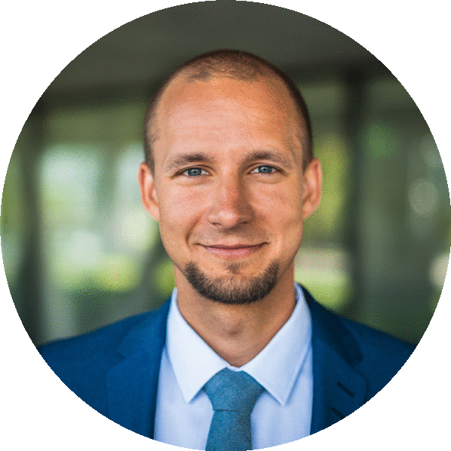







Vilnius Tech Leads: The Agile One
Nerijus Kliukas | Agile Coach
Notes:
Thank you
Me: 1) Previously experience in Finance Sector, 2) Project managment background, 3) Scrum Master – now Agile Coach.
Genius Sports is a global leader in sports data technology, distribution and commercialization services.

Slide 2
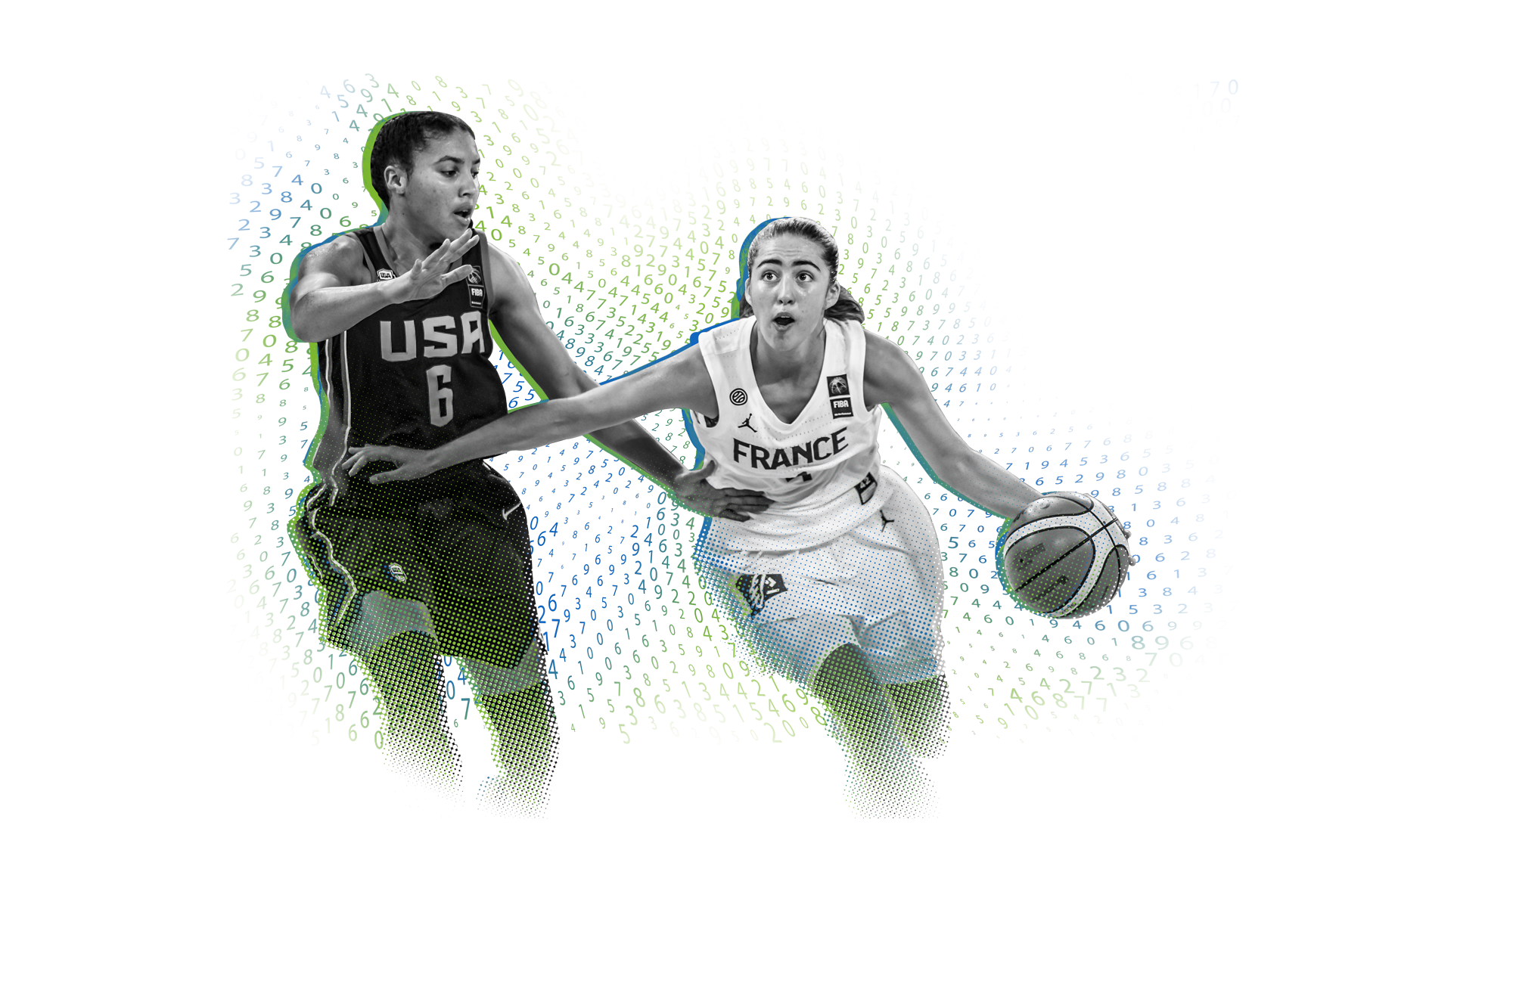
How experienced are you with Agile?
Notes:
Work experiance with Agile:
10 years
5 years
1-2 years
<1 year

Slide 3












12 Agile Principles
Customer Satisfaction
Welcome Change
Deliver Frequently
Working Together
Motivated Team
Face to Face
Working Software
Constant Pace
Good Design
Simplicity
Self Organization
Reflect & Adjust
Notes:
Agile is the ability to create and respond to change. It is a way of dealing with, and ultimately succeeding in, an uncertain and turbulent environment.
Agile software development is an umbrella term for a set of frameworks (Scrum, XP, FDD) and practices (pair programming, TDD, Daily Scrums, Sprints, etc.) based on the values and principles expressed in the Manifesto for Agile Software Development and the 12 Principles behind it.
5. Build projects around motivated individuals. Give them the environment and support they need, and trust them to get the job done.
6. The most efficient and effective method of conveying information to and within a development team is face-to-face conversation.
10. Simplicity—the art of maximizing the amount of work not being done—is essential.
11. The best architectures, requirements and designs emerge from self-organizing teams.
12. At regular intervals, the team reflects on how to become more effective, then tunes and adjusts its behavior accordingly.

Slide 4
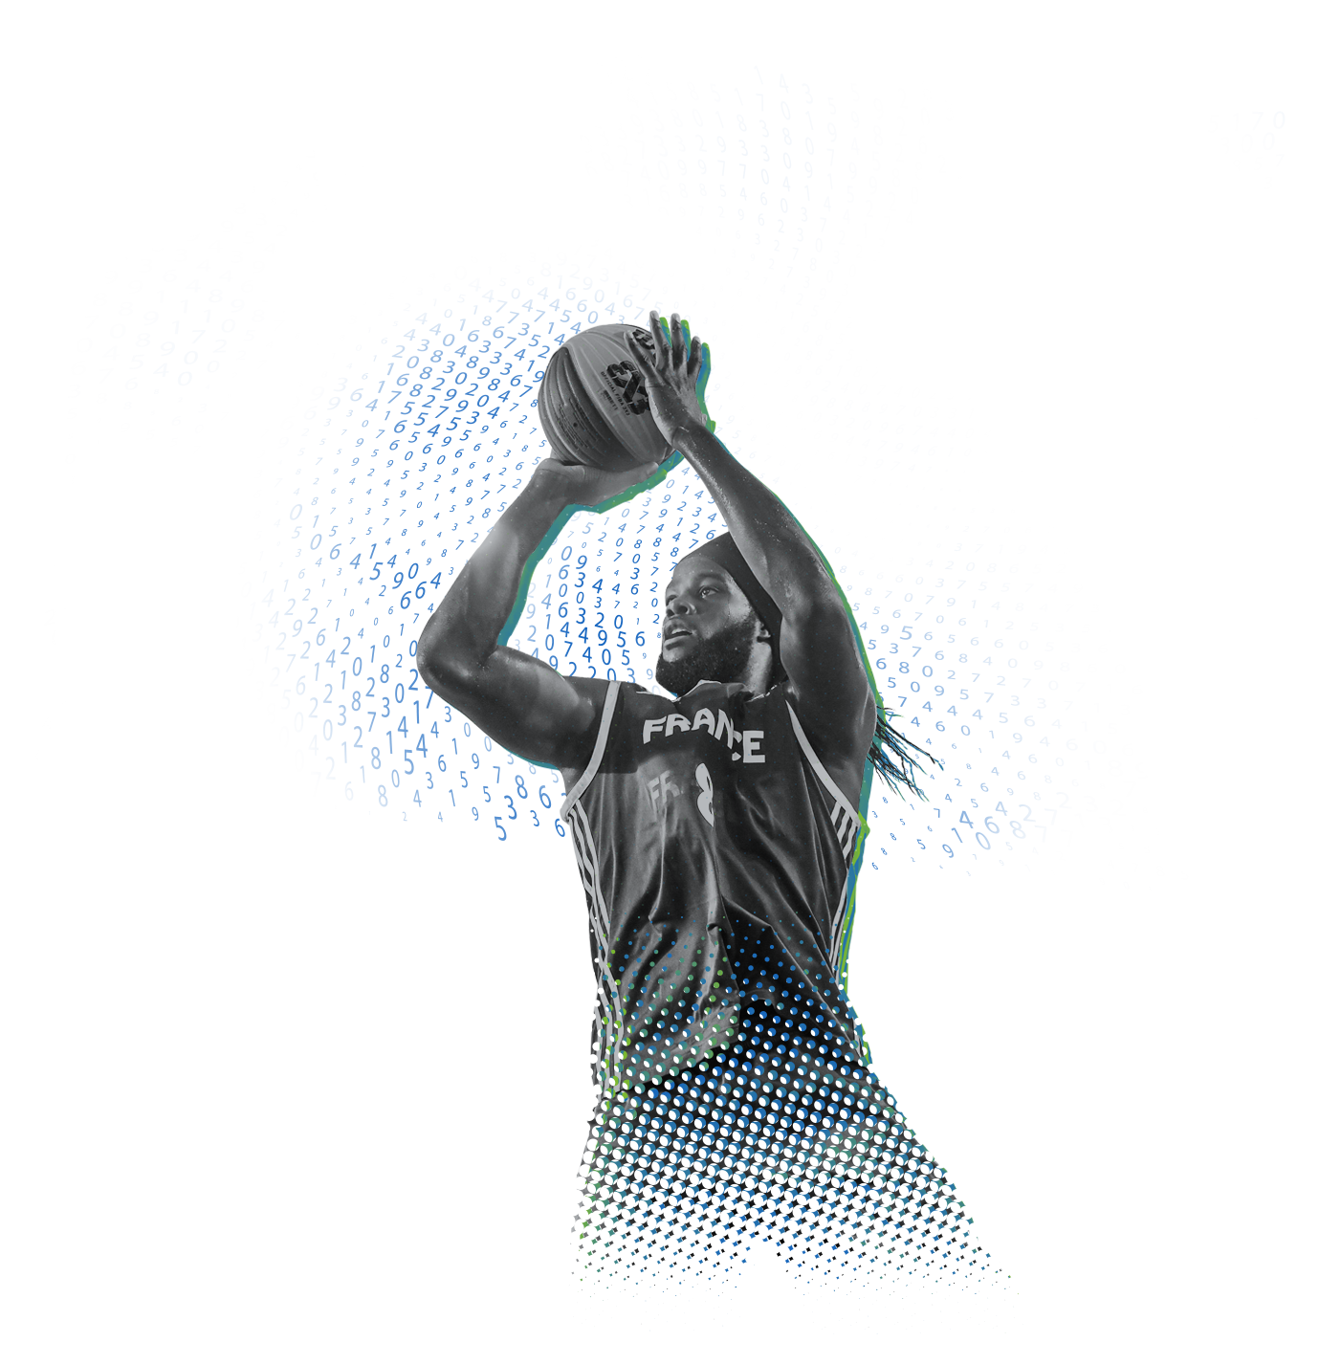
Agile is not a silver bullet
It won’t solve all your challenges
You will have to solve it yourself
Notes:
Agile is not a goal. It is only means to an end.
You need to know why you want to follow Agile mindset – what business goals it will help you to achieve.
DO Agile vs. BE Agile.
E.g. Management does not know why we use Agile and what business goals do we want to achieve with it.

Slide 5
80 % experiments do not work
Reflect & Adjust
Experiment a lot
Inspect and adapt
Notes:
At regular intervals, the team reflects on how to become more effective, then tunes and adjusts its behavior accordingly.
If you are not satisfied with results – you need to changes something. If you’ll repeat the same process over and over again, you will get the same result.
E.g. Meeting agreements worked with one team, but it didn’t with another team
E.g. Golf. Aim: Small changes with big result.

Slide 6
I haven’t seen self-organized team yet
Self Organization
Attitude over skills
Motivated Team
1) Humble, 2) Hungry, 3) (People) Smart
Notes:
The best architectures, requirements and designs emerge from self-organizing teams
Build projects around motivated individuals. Give them the environment and support they need, and trust them to get the job done
‘The Ideal Team Player’ by Patrick Lencioni
E.g. Humble & hunger developer promoted to be senior developer being without people smarts.

Slide 7
Face to Face
Functional vs. Cross-functional teams
Simplicity
Notes:
The most efficient and effective method of conveying information to and within a development team is face-to-face conversation.
Simplicity—the art of maximizing the amount of work not being done—is essential.
E.g. 1) F/E integration with 2) B/E failed and 3) QA team waiting for integration to happen for them to start testing

Slide 8



Agile ≠ hype
Motivated Team
Agile =
Self Organization
Reflect & Adjust
Notes:
Agile is not all about the hype.
It is about motivated people in self-organized teams thriving on experimentation.

Slide 9
Questions?

Slide 10

Thank you

Slide 11
Appendix

Slide 12



Ideal Agile Team Member: Interview questions
Humble:
Tell me about the most important accomplishments of your career.
What was the most embarrassing moment in your career? Or biggest failure?
How did you handle that embarrassment or failure?
What is your greatest weakness?
How do you handle apologies, either giving or accepting them?
Tell me about someone who is better than you in an area that really matters to you.
Great team players lack excessive ego or concerns about status. They are quick to point out the contributions of others and slow to seek attention for their own. They share credit. Emphasize team over self, and define success collectively rather than individually.
Humble
Always looking for more. More things to do. More to learn. More responsibility to take. Hungry people almost never have to be pushed by a manager to work harder because they are self-motivated and diligent.
Hungry:
What is the hardest you’ve ever worked on something in your life?
What do you like to do when you’re not working?
Did you work hard when you were a teenager?
What kind of hours do you generally work?
Hungry
Smart simply refers to a person’s common sense about people. Smart people tend to know what is happening in a group situation and how to deal with others in the most effective way. They as good questions, listen to what others are saying, and stay engaged in conversations intently.
(People) Smart:
How would you describe your personality?
What do you do that others in your life might find annoying?
What kind of people annoy you the most, and how do you deal with them?
Would your former colleagues describe you as an empathic person?
Can you give me an example of how you’ve demonstrated empathy to a teammate?
(People) Smart

